Slide 1
Time Series
Tomas Karpati MD karpati@it4biotech.com
054-2002430

Slide 2
Time-Series models
In a common regression problem we have two variables: the dependent (y) and the independent (x) variables. We want to predict y using x.
y = 𝝱₁x + 𝝱₀
In time series we have only one variable (a) that occurs at regular time. Here we want to predict a at a time frame t given a previous a in a past time frame (t-1).
a_{t} = 𝝱₁a_{t-1} + 𝝱₀
Autoregressive model (AR)

Slide 3
Time-Series models
Time series data have the following challenges:
The temporal component has a huge influence
A high autocorrelation exist that can affect the model generation
The common error metrics can be inaccurate when analyzing TS derived model
Multivariable models in the presence of TS are not easy to implement

Slide 4
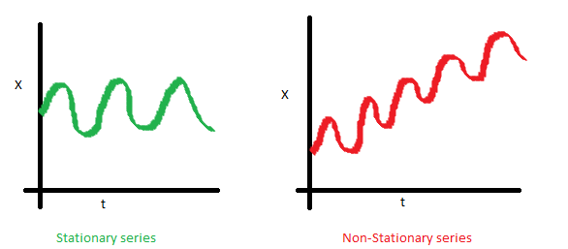
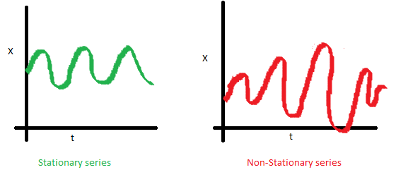
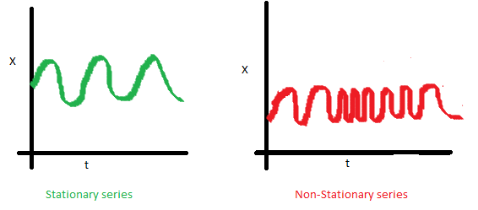
Time-Series models
Stationary Time Series
The mean must be constant and not changing over time
The variance must not change over time
The covariance must not change over time

Slide 5
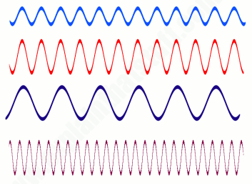
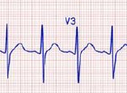
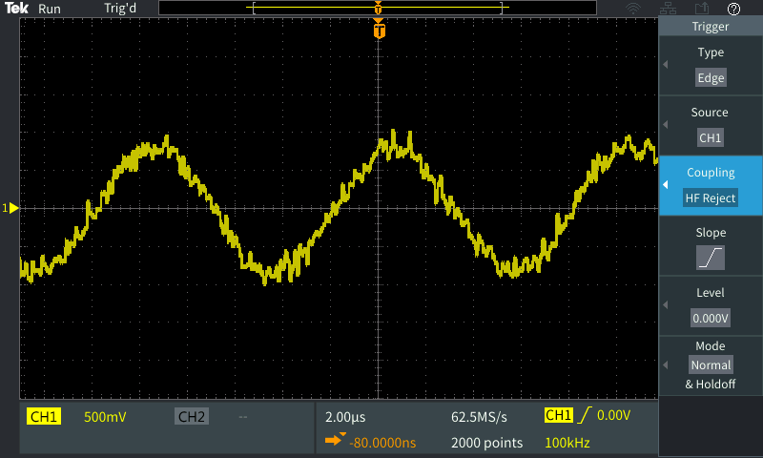
Time-Series models
Stationary Time Series
A stationary time series is one whose properties do not depend on the time at which the series is observed

Slide 6
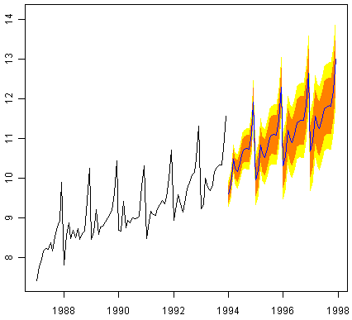
Time-Series models

Slide 7
Time-Series models
Non-Stationary Time Series
The statistical methods used for forecasting time series assume a stationary TS
To be able to analyze a non-stationary TS we need to apply some type of transformation to make it stationary
There are two main ways to make such a transformation:
Differencing: compute the differences between consecutive observations
Decomposition: statistical method that deconstructs a time series into three main components: trend, seasonal and noise

Slide 8
Time-Series models
Non-Stationary Time Series
Differencing: compute the differences between consecutive observations
After differencing we have to check if the obtained residuals are able to predict the the next value
The residual has to preserve some autocorrelation
To test this we use the Ljung-Box test (Box test). If the p-value is significant, the residuals can be used for forecasting. Else, the residuals are random (white noise)

Slide 9
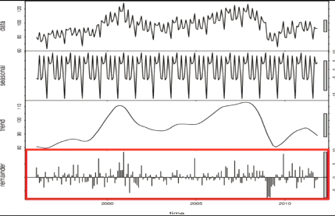

Time-Series models
Non-Stationary Time Series
Decomposition of TS is statistical method that deconstructs a time series into three main components: trend, seasonal and noise
Seasonality: variations occurring at regular time periods
Trend: main direction of the time series
Noise: changes on short irregular time periods (random noise)
Data
Season
Trend
Noise

Slide 10
Time-Series models
Forecasting
Univariate Time Series
AutoRegressive (AR(p))
Moving Average (MA(q))
ARMA(p,q)
ARIMA(p,d,q) [i=integrated]
ARCH(p) [AR-conditional heteroskedasticity]
GARCH(p,q)
Multivariate Time Series
Vector Autoregression (VAR)
AR(1) a_{t} = 𝝱₀ + 𝞍a_{t-1} + 𝞊_{t}
MA(1) a_{t} = 𝝱₀ + 𝞍𝞊_{t-1} + 𝞊_{t}
ARMA(1,1) a_{t} = 𝝱₀ + 𝝱a_{t-1} 𝞍𝞊_{t-1} + 𝞊_{t}
ARIMA(1,0,1) [automatic decomposition of the TS]
ARCH(1) a_{t} = 𝞊_{t} √ 𝝰 + (𝝰a_{t-1})²
GARCH(1) a_{t} = 𝞊_{t} √ 𝝰 + (𝝰a_{t-1})² 𝝱𝞂_{t-1}

Slide 11
ARIMA
Forecasting univariate time series
ARIMA - also known as the Box-Jenkin methodology
Season
Trend
Noise

Slide 12

Time-Series models
Correlation
Autocorrelation
Function (ACF)
a_{t}, a_{t-1}
a_{t},a_{t-1}
a_{t}, a_{t-1}
a_{t}
a_{t-1}
Partial Autocorrelation
Function (PACF)
Measures the association between a_{t} and a_{t-1} when the effect of other time lags (a_{t-p}) are removed.

Slide 13
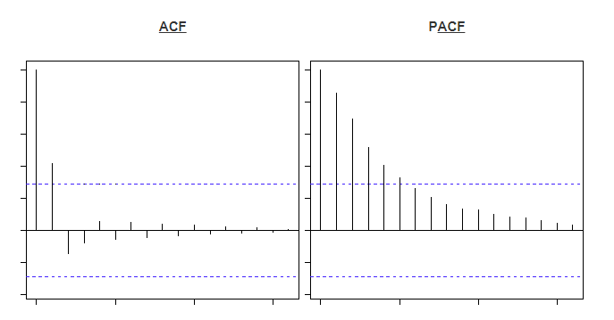
Time-Series models
Correlograms
ACF
PACF
The correlogram helps us to decide which lags are the most efficients for running the AR(p) and MA(q) components
p ≥ 0.05

Slide 14
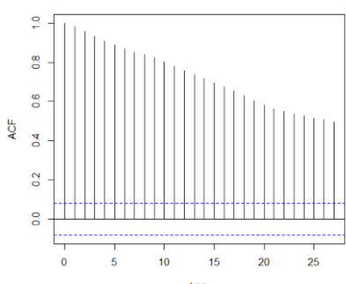
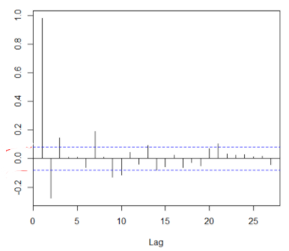
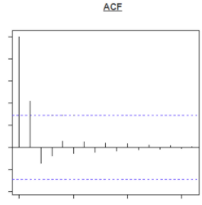
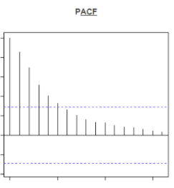
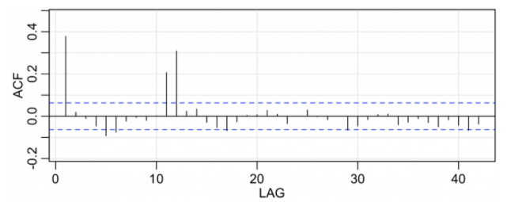
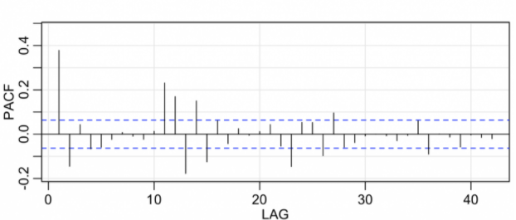
Time-Series models
Model | ACF | PACF
AR
MA
ARMA

Slide 15
Time-Series models
Metrics for selecting the best model:
AIC
BIC
R²

Slide 16
Time-Series models
Multivariate TS models: Vector Autoregression (VAR)
AR(1) T_{t} = 𝝱₁₁T_{t-1} + 𝝱₁₂R_{t-1} + 𝞊_{Tt}
R_{t-1} T_{t-1}
R_{t} T_{t}
AR(1) R_{t} = 𝝱₂₁T_{t-1} + 𝝱₂₂R_{t-1} + 𝞊_{Rt}
𝝱₁₁ 𝝱₁₂ T_{t-1}
VAR(1) f(t) = x + 𝞊_{t}
𝝱₂₁ 𝝱₂₂ R_{t-1}
T=temperature | R=rain

